Slide 1
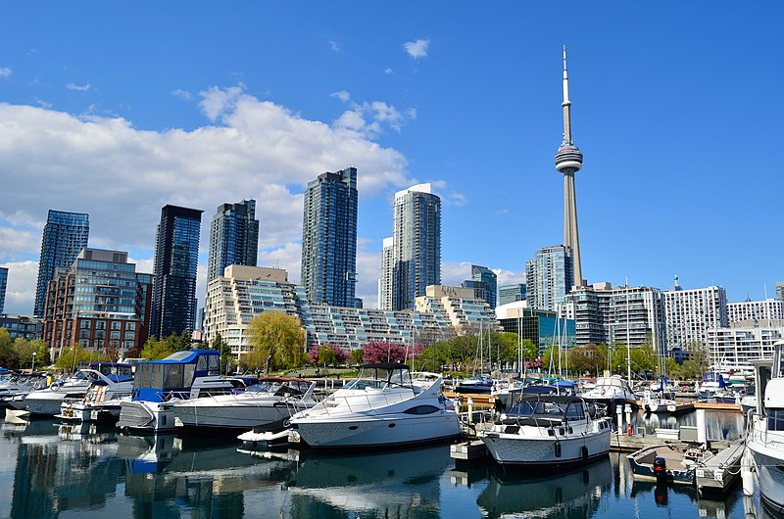
Introduction
This project is for who is planning to open a Persian restaurant in Toronto.
This project suggests the best locations for Persian restaurant in Toronto.
This report explores which neighborhoods of Toronto have the most as well as the best Persian restaurant.
Also, this project answers the questions “Where should I open a Persian restaurant?”

Slide 2
Data
Districts of Toronto are obtained from:
https://en.wikipedia.org/w/index.php?title=List_of_postal_codes_of_Canada:_M&oldid=942655364
Latitude and Longitude values are obtained by using "geocoder".
All data related to locations are obtained by using Foursquare API and Python Libraries.

Slide 3
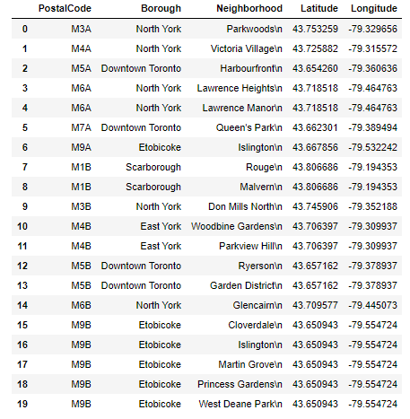
Methodology
Fetching data which includes “PostalCode”, “Borough” and “Neighborhood” information of the city of Toronto and then merging with latitude and longitude.
Python Folium library is used to visualize map of Toronto and its districts. In order to get Latitude and Longitudes of Toronto, geopy and geocoder are used.
In order to explore and categorize places Foursquare API is used. Here is the head of the data frame.

Slide 4
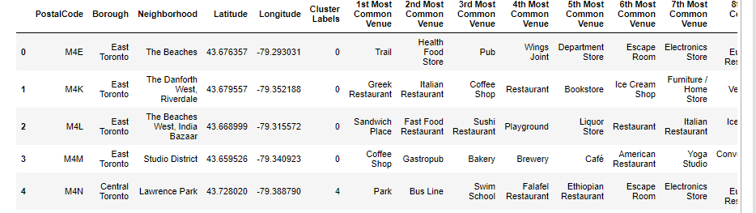
Methodology
Then using kmeans clustering algorithm with the value of 5 for K, the districts of Toronto is clustered into 5 different categories. Here is the head of the data frame.

Slide 5
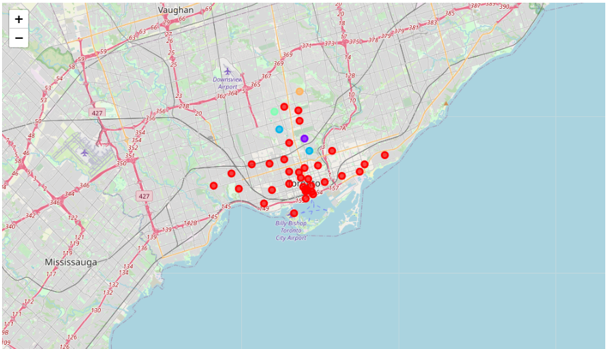
Now plotting map with neighborhoods which are clustered by color.

Slide 6
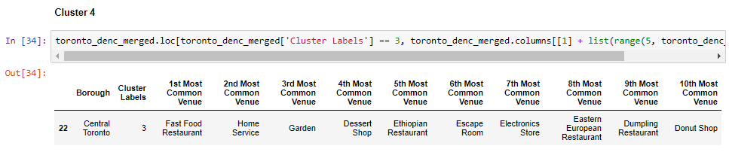
Results
After carefully observing each cluster, it is crystal clear that the central Toronto (Cluster 3) is the best place to open a Persian restaurant, since it is the most crowded place in Toronto and in addition it has the most restaurant in Toronto. Here is the head:

Slide 7
Discussion and Conclusion
Kmeans algorithm is used as part of this clustering project. The value of K is set to 5 to get a optimum result. For more detailed and accurate guidance, the data set can be expanded, and the details of the neighborhood or street can also be drilled.
It is obvious that Cluster 4 is the most viable cluster to open a new Persian restaurant. Especially Cluster 4 (Central Toronto district) has the most common venues as restaurant. So it is a hot spot for ordering and eating meal for people in Toronto.

